Slide 1

Java In Container
Mateusz Dymiński

Slide 2
whoami
Mateusz Dymiński
Software Developer at Nokia
8+ exp with Java
5+ exp with Go
One of the organizer GoWroc - Golang Wroclaw Meetup
Page: mateuszdyminski.com
Github: github.com/mateuszdyminski
Twitter: @m_dyminski
LinkedIn: linkedin.com/in/mdyminski

Slide 3
Agenda
Demo app
Signaling in containers
Choosing container base image
Layering demo app
Multistage builds
Java Ergonomics
Security
Google JIB
Extras
Summary

Slide 4

github.com/mateuszdyminski/java-in-container

Slide 5

Let’s Build Application

Slide 6
Users Application
Users Service
REST API
Storage: MySQL

Slide 7
User
@Entity @Table(name = "users") public class User { @Id @GeneratedValue(strategy = GenerationType.IDENTITY) private Integer id; private String firstName; private String secondName; @Temporal(TemporalType.TIMESTAMP) private Date birthDate; public Integer getId() { return id; } public String getFirstName() { return firstName; } public String getSecondName() { return secondName; } public Date getBirthDate() { return birthDate; } }

Slide 8
Users Controller
@RestController @RequestMapping("/api") public class UsersController { @Autowired UserRepository userRepository; @GetMapping("/users") public List<User> getAllUsers() { return userRepository.findAll(); } @PostMapping("/users") public User createUser(@Valid @RequestBody User user) { return userRepository.save(user); } @GetMapping("/users/{id}") public User getUserById(@PathVariable(value = "id") Integer userId) { return userRepository.findById(userId) .orElseThrow(() -> new ResourceNotFoundException("User", "id", userId)); } }

Slide 9
Demo Users Service
Build Users Service
Run
Open
$ mvn package
$ java -jar target/users-app-1.0.jar
http://localhost:8080/api/users

Slide 10
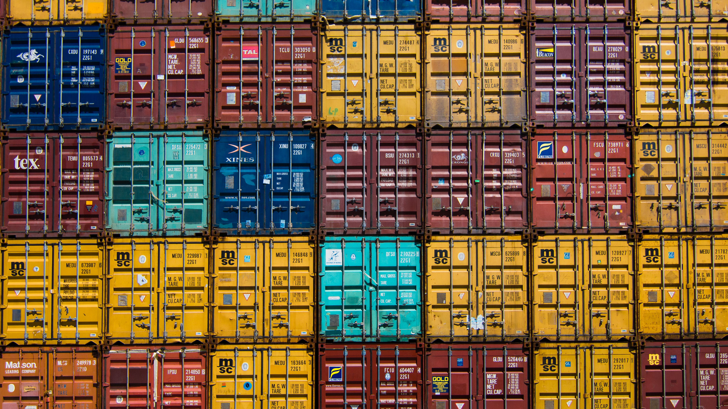
Let’s Dockerize Users App

Slide 11
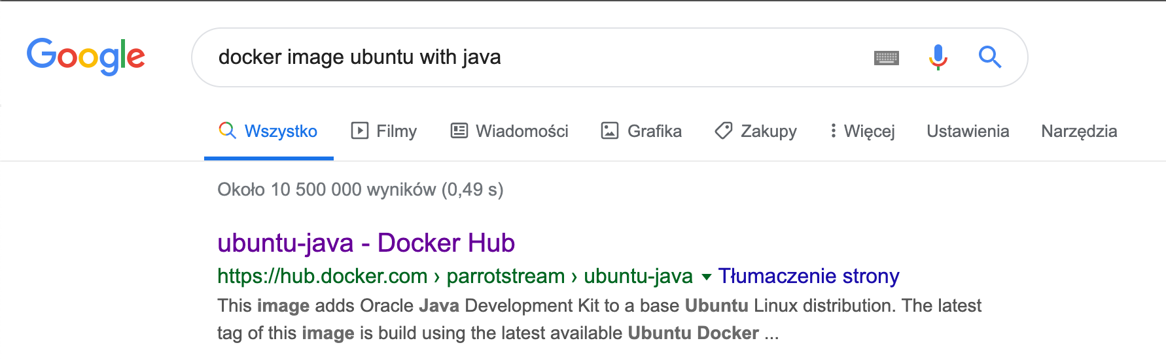

Slide 12
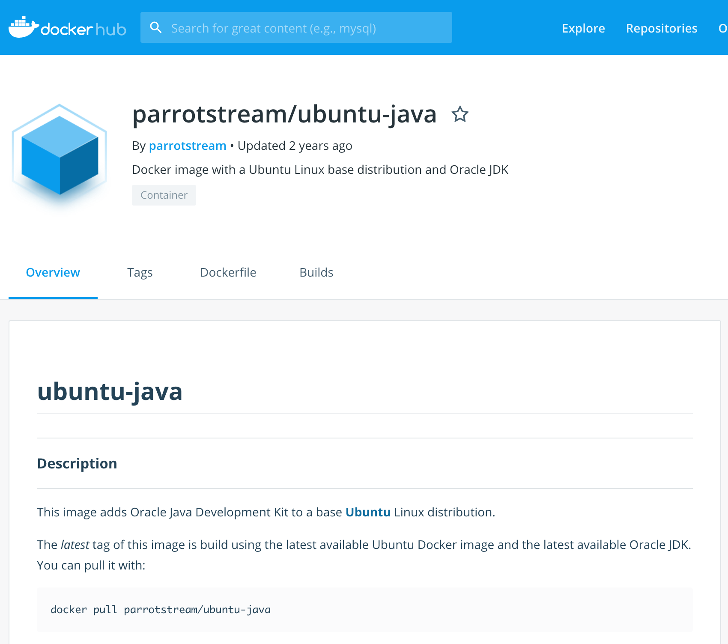

Slide 13
Our very first Dockerfile
FROM parrotstream/ubuntu-java
RUN mkdir -p /var/users-app
COPY target/users-app-1.0.jar /var/users-app/users-app-1.0.jar
COPY run.sh /var/users-app/run.sh
ENTRYPOINT "/var/users-app/run.sh"
And run.sh
#!/usr/bin/env sh
echo "Running users App" /usr/lib/jvm/java-8-oracle/bin/java -jar /var/users-app/users-app-1.0.jar

Slide 14

Let’s get ready for rumble!

Slide 15
Signaling – Entrypoint
We have 2 options while creating ENTRYPOINT:
or different exec where command line is like JSON array:
Long story short: always use the array exec form. The shell form runs your entrypoint as a subcommand of /bin/sh -c which comes with a load of problems, one of them notably that you’ll never see a signal in your application.
ENTRYPOINT "/usr/bin/java -jar /var/users-app/app-1.0.jar"
ENTRYPOINT ["java”, „-jar”, ”/var/users-app/app-1.0.jar”]

Slide 16
Signaling – Script as Entrypoint
Some applications are not suited to be run in ENTRYPOINT and require some logic before they can be started
Use exec - Instead of forking a new process from the existing bash it replaces the shell
Use:
Instead of:
exec /app/bin/your-app
/app/bin/your-app

Slide 17
Signaling part - summary
Use the exec/JSON array form of ENTRYPOINT.
Use exec in shell entrypoints.
Don’t pipe your application’s output.
Avoid being PID 1.
Listen for SIGTERM or set STOPSIGNAL in your Dockerfile.

Slide 18
Our Dockerfile v2
FROM parrotstream/ubuntu-java
RUN mkdir -p /var/users-app
COPY target/users-app-1.0.jar /var/users-app/users-app-1.0.jar
ENTRYPOINT ["/usr/lib/jvm/java-8-oracle/bin/java", "-XshowSettings:VM", "-XX:NativeMemoryTracking=summary", "-jar", "/var/users-app/users-app-1.0.jar"]

Slide 19
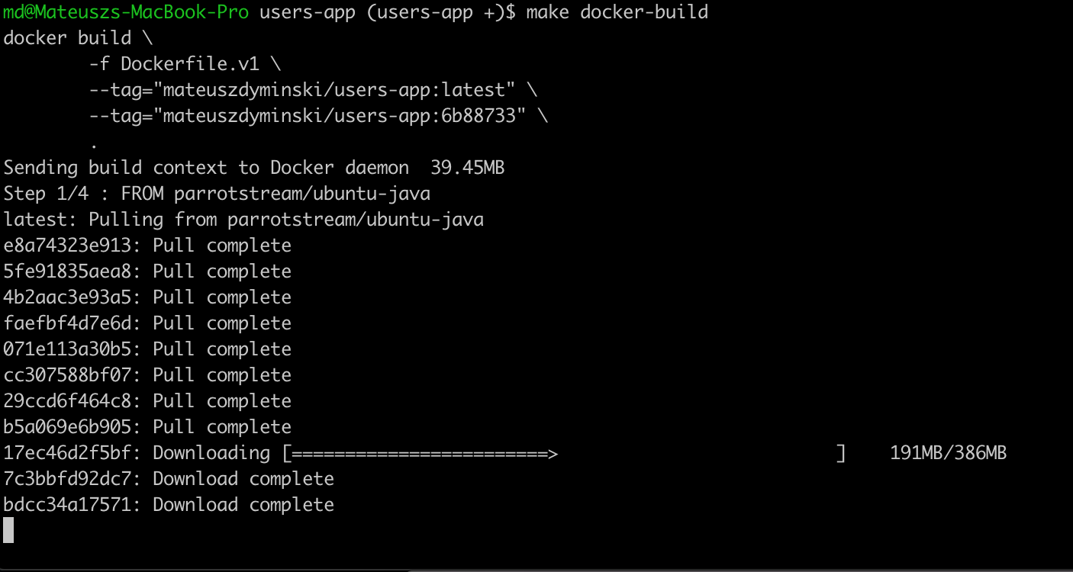


Slide 20
Checking image size
It’s 881mb !!!!!!!!!!!!!!!!!!!!!!!!!!!!!!!!

Slide 21
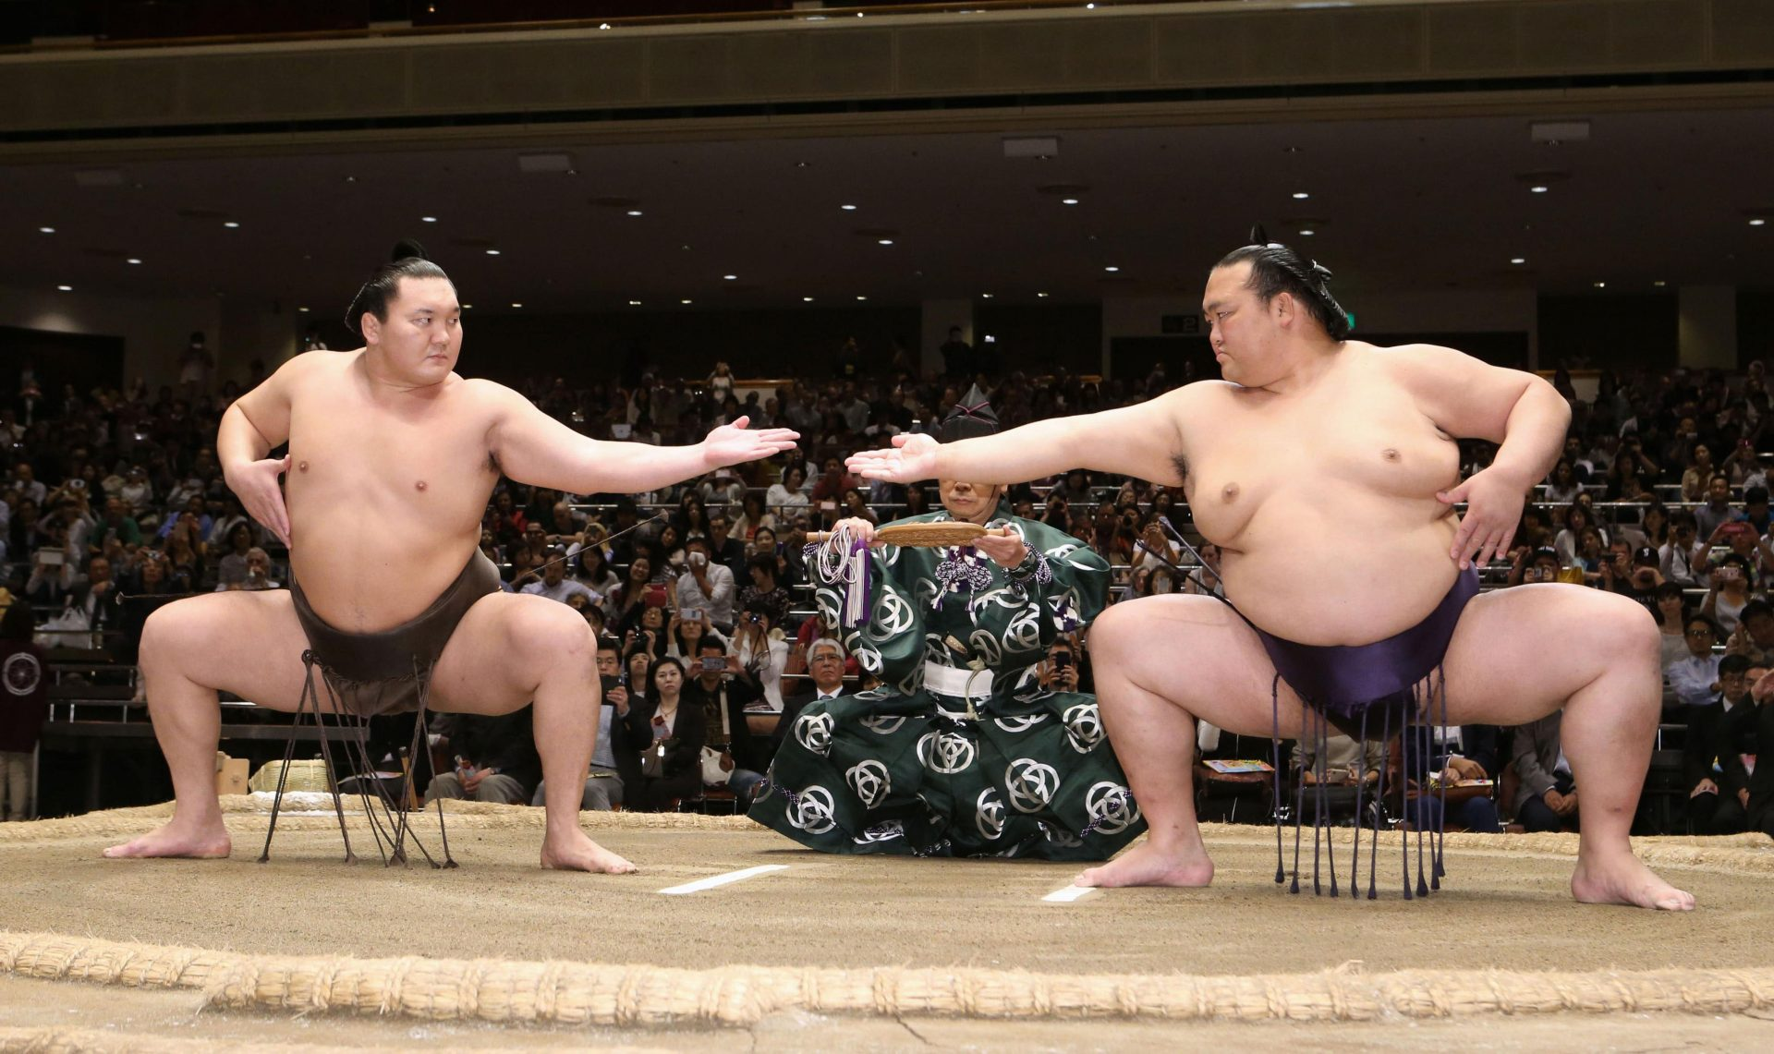
Choosing Container Base Image

Slide 22
First problem: Your Java Runtime
Oracle JDK
OpenJDK builds by Oracle
AdoptOpenJDK builds
AdoptOpenJDK OpenJ9 builds
Linux (Red Hat, Debian, Fedora, Arch, Ubuntu) OpenJDK builds
Azul Zulu
Amazon Corretto
SAP SapMachine
Liberica from Bellsoft

Slide 23
Second problem: Base Linux Image
Decision is based on Java Runtime
Do we rely on external OS toolbox? curl, wget, etc.
Do we really care about the size of image?
Security!
We need to choose distro which is free from CVE
Less components that can be exploited and smaller attack surface

Slide 24
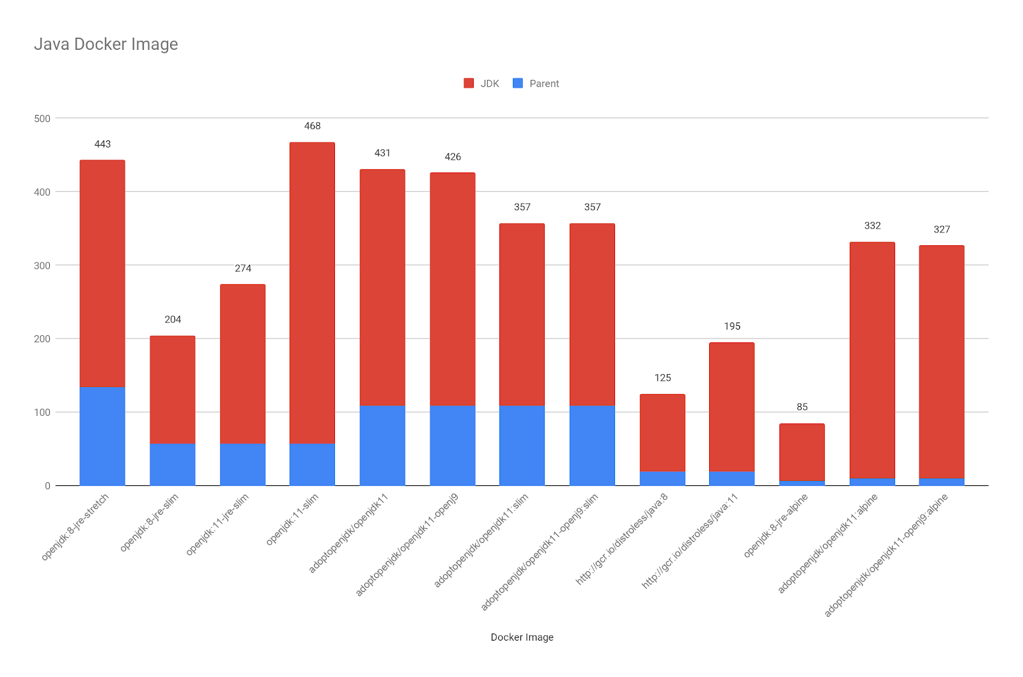

Slide 25

Let’s get Alpine then

Slide 26
Alpine
Lightweight Linux distribution based on musl libc and busybox
musl is a “libc”, an implementation of the standard library functionality described in the ISO C and POSIX standards
musl is a new general-purpose implementation of the C library. It is lightweight, fast, simple, free, and aims to be correct in the sense of standards-conformance and safety.
is basically the standardized interface between the kernel and userland

Slide 27
Project Partola
OpenJDK repository contains of many C/C++ code (around 19%)
The JVM has been already ported to glibc
But in order to ensure a transparent run of the JVM (and its C/C++ code) on musl, an effort should be made to port the JVM to it as well.
This is the goal of OpenJDK “Project Portola” is available as part of java 13.
It still in experimental status, needs more hardening and no GA is available for the moment.

Slide 28
Our Dockerfile 3
FROM openjdk:8-jre-alpine
RUN mkdir -p /var/users-app
COPY target/users-app-1.0.jar /var/users-app/users-app-1.0.jar
ENTRYPOINT ["java", "-XshowSettings:VM", "-XX:NativeMemoryTracking=summary", "-jar", "/var/users-app/users-app-1.0.jar"]

Slide 29
Checking image size
It’s 124mb !!!!!!!!!!!!!!!!!!!!!!!!!!!!!!!!
Was 881mb

Slide 30
Other options to make image smaller
Java
Java Modularity
Code refactoring
Dependencies
Docker
Smaller base image
Layers & Caching (dockerfilelint)
Dockerignore (faster builds)
Multistage Build
docker-squash

Slide 31

Let’s change business logic

Slide 32
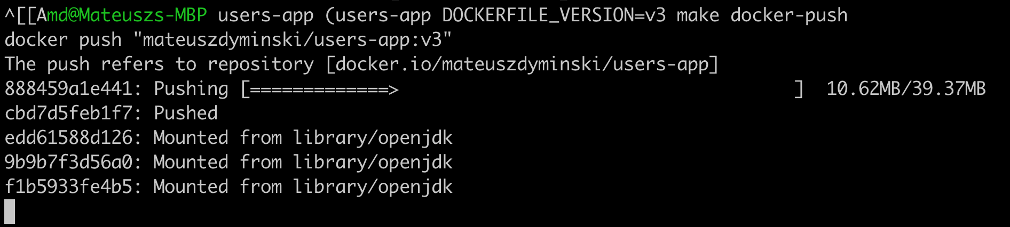

Problem:

Slide 33
Solution: Unpack Fat JAR
Build Users Service
Unpack JAR to create external and internal deps:
$ mvn clean package
$ mkdir target/dependency
$ (cd target/dependency; tar -zxf ../*.jar)

Slide 34
Our Dockerfile 4
FROM openjdk:8-jre-alpine
RUN mkdir -p /var/users-app
COPY target/dependency/BOOT-INF/lib /var/users-app/lib
COPY target/dependency/META-INF /var/users-app/META-INF
COPY target/dependency/BOOT-INF/classes /var/users-app
ENTRYPOINT [ "java", \
"-XshowSettings:VM", \
"-XX:NativeMemoryTracking=summary", \
"-cp", "/var/users-app:/var/users-app/lib/*", \
"com.example.users.UsersApp"]

Slide 35
Pros of unpacking JAR
Really fast Docker builds
Only real changes are send over the network to Registry
Less space are ocupied both on Local machine and Registry

Slide 36
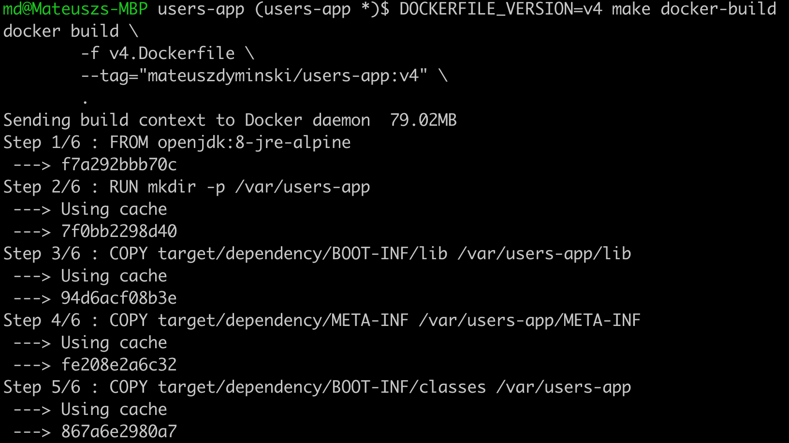

Another Problem(s)
We need to build out Java App on our local machine

Slide 37
Solution: Multistage Builds
FROM openjdk:8-jdk-alpine as build
WORKDIR /workspace/users-app
COPY mvnw .
COPY .mvn .mvn
COPY pom.xml .
COPY src src
RUN ./mvnw install -DskipTests
RUN mkdir -p target/dependency && (cd target/dependency; jar -xf ../*.jar)
FROM openjdk:8-jre-alpine
RUN mkdir -p /var/users-app ARG DEPENDENCY=/workspace/users-app/target/dependency COPY --from=build ${DEPENDENCY}/BOOT-INF/lib /var/users-app/lib
COPY --from=build ${DEPENDENCY}/META-INF /var/users-app/META-INF
COPY --from=build ${DEPENDENCY}/BOOT-INF/classes /var/users-app
ENTRYPOINT [ "java", \
"-XshowSettings:VM", \
"-XX:NativeMemoryTracking=summary", \
"-cp", "/var/users-app:/var/users-app/lib/*", \
"com.example.users.UsersApp"]
BUILD
Run

Slide 38
Pros of Unpacking JAR
We don’t need to send all deps to docker process only src
All deps are cached by Docker
Builds are reproducible and do not depends on VM where build phase is run

Slide 39

Java Ergonomics

Slide 40
Java Ergonomics
The JVM has plenty of ergonomics which are based on the underlying system
Memory
CPUs
Exact CPU model
Garbage collector
JIT Optimizations
Your friends:
-XX:+PrintFlagsFinal
-XX:+PrintGCDetails
-XshowSettings:VM
-XX:NativeMemoryTracking=summary

Slide 41
Java 8u121 and before

Slide 42

There is a hope…

Slide 43
Fabric8
# Based on the cgroup limits, figure out the max number of core we should utilize
core_limit() {
local cpu_period_file="/sys/fs/cgroup/cpu/cpu.cfs_period_us"
local cpu_quota_file="/sys/fs/cgroup/cpu/cpu.cfs_quota_us"
if [ -r "${cpu_period_file}" ]; then
local cpu_period="$(cat ${cpu_period_file})"
if [ -r "${cpu_quota_file}" ]; then
local cpu_quota="$(cat ${cpu_quota_file})"
# cfs_quota_us == -1 --> no restrictions
if [ ${cpu_quota:-0} -ne -1 ]; then
echo $(calc 'ceil($1/$2)' "${cpu_quota}" "${cpu_period}")
fi
fi
fi
}
max_memory() {
# High number which is the max limit until which memory is supposed to be
# unbounded.
local mem_file="/sys/fs/cgroup/memory/memory.limit_in_bytes"
if [ -r "${mem_file}" ]; then
local max_mem_cgroup="$(cat ${mem_file})"
local max_mem_meminfo_kb="$(cat /proc/meminfo | awk '/MemTotal/ {print $2}')"
local max_mem_meminfo="$(expr $max_mem_meminfo_kb \* 1024)"
if [ ${max_mem_cgroup:-0} != -1 ] && [ ${max_mem_cgroup:-0} -lt ${max_mem_meminfo:-0} ]
then
echo "${max_mem_cgroup}"
fi
fi
}
Source: github.com/fabric8io-images/run-java-sh

Slide 44
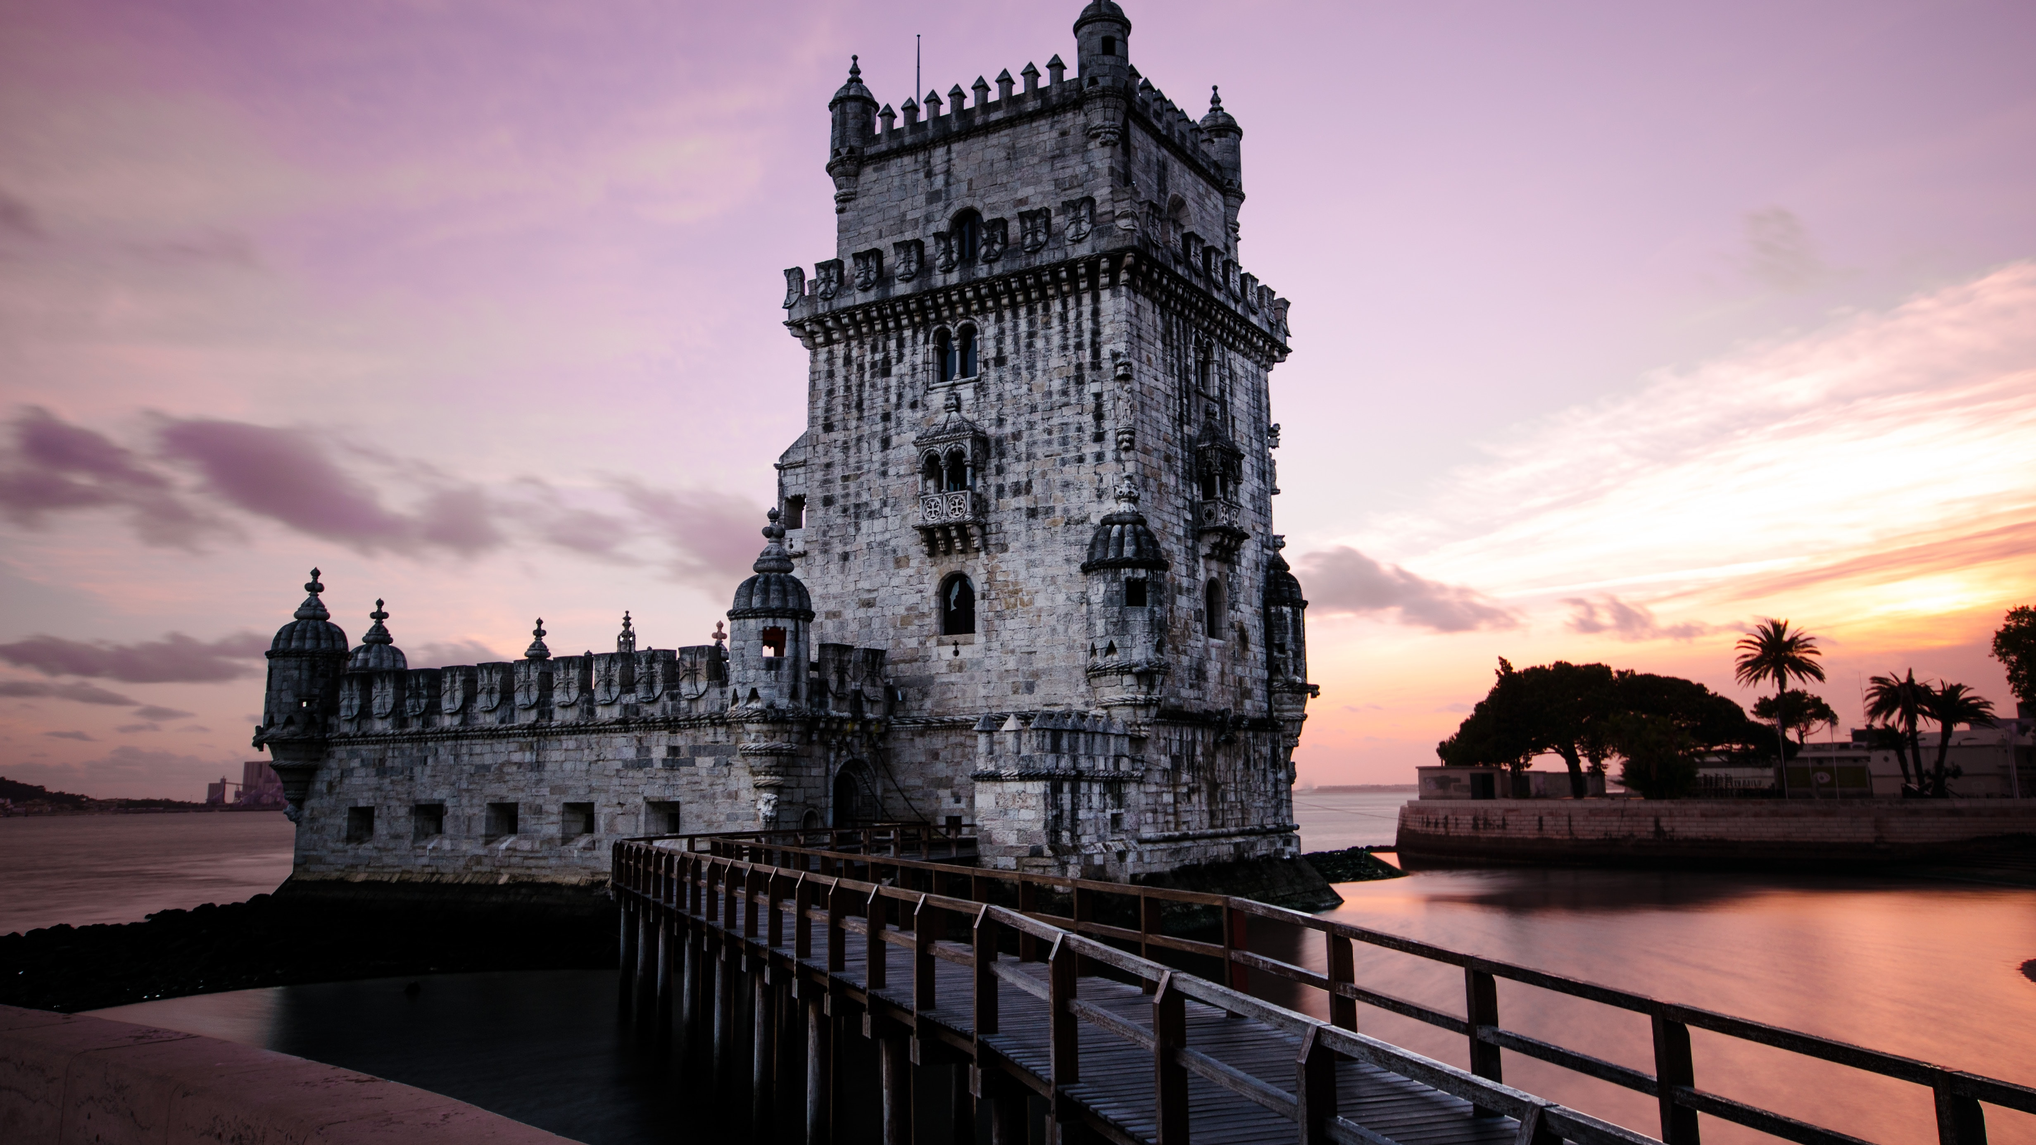
Java 9, 8u121+

Slide 45
Java 9, 8u121+
CPU configuration:
-XX:ParallelGCThreads and -XX:CICompilerCount are set based on Containers CPU limits (can be overridden) calculated from
--cpuset-cpus
Memory Configuration:
-XX:+UnlockExperimentalVMOptions
-XX:+UseCGroupMemoryLimitForHeap
-XX:MaxRAMFraction to 2 (default is 4)

Slide 46
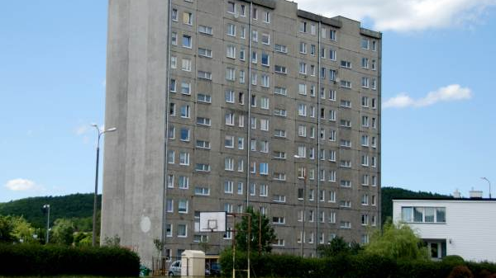
Java 10+, 8u191+

Slide 47
Java 10+, 8u191+
More container awareness
Improve heap memory allocations [JDK-8196595]:
-XX:InitialRAMPercentage, -XX:MaxRAMPercentage, and -XX:MinRAMPercentage
-XX:InitialRAMFraction, -XX:MaxRAMFraction, and -XX:MinRAMFraction are Deprecated
The total number of CPUs available to the Java process is calculated from --cpus, --cpu-shares, --cpu-quota [JDK-8146115]
Use -XX:-UseContainerSupport to return to the old behavior
# processors that the JVM will use internally -XX:ActiveProcessorCount
Attach in linux became be relative to /proc/pid/root and namespace aware (jcmd, jstack, etc)

Slide 48

Java 11+

Slide 49
Java 11+
More container awareness
Removes -XX:+UnlockExperimentalVMOptions, -XX:+UseCGroupMemoryLimitForHeap [JDK-8194086]
jcmd -l and jps commands do not list JVMs in Docker containers [JDK-8193710]
Container Metrics (-XshowSettings:system) [JDK-8204107]
Update CPU count algorithm when both cpu shares and quotas are used [JDK-8197867]
-XX:+PreferContainerQuotaForCPUCount

Slide 50
Java Ergonomics Summary
If you really can’t change the Java version in your docker to modern one – User Fabric8 Script to wrap execution of your app
If you can
Start with java 11
or at least 8u191+

Slide 51
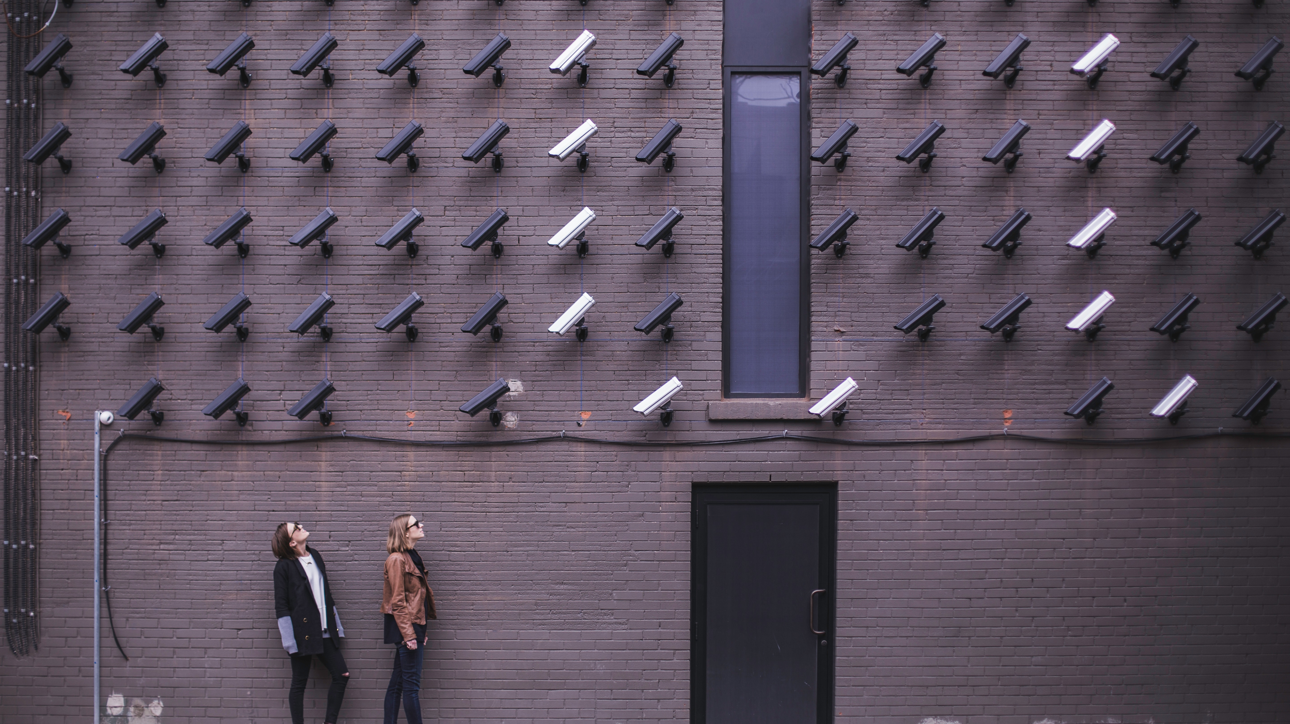
Security

Slide 52
Security in Containers
Know what is in your container
Vulnerability scanning – eg. Clair
Docker Content Trust
Minimal container OS (Minimal attack surface)
Monitoring & Auditing

Slide 53
Security in Containers
Limit privileges:
Change USER to non-root
Run container with read-only filesystems
Limit resources

Slide 54
Our Dockerfile 6
FROM openjdk:8-jdk-alpine as build
WORKDIR /workspace/users-app
COPY mvnw .
COPY .mvn .mvn
COPY pom.xml .
COPY src src
RUN ./mvnw install -DskipTests
RUN mkdir -p target/dependency && (cd target/dependency; jar -xf ../*.jar)
FROM openjdk:8-jre-alpine
RUN addgroup -S app && adduser -S -G app app
USER app
RUN mkdir -p /home/app/users-app
ARG DEPENDENCY=/workspace/users-app/target/dependency
COPY --from=build ${DEPENDENCY}/BOOT-INF/lib /home/app/users-app/users-app/lib
COPY --from=build ${DEPENDENCY}/META-INF /home/app/users-app/users-app/META-INF
COPY --from=build ${DEPENDENCY}/BOOT-INF/classes /home/app/users-app/users-app
ENTRYPOINT [ "java", \
"-XshowSettings:VM", \
"-XX:NativeMemoryTracking=summary", \
"-cp", "/home/app/users-app/users-app:/home/app/users-app/users-app/lib/*", \
"com.example.users.UsersApp"]
Magic

Slide 55

Clair
Clair is an open source project for the static analysis of vulnerabilities in application containers
In regular intervals, Clair ingests vulnerability metadata from a configured set of sources and stores it in the database.
Clients use the Clair API to query the database for vulnerabilities of a particular image

Slide 56
Clair-Scanner
Client for Clair - github.com/arminc/clair-scanner
Usage:
$ clair-scanner alpine:3.5
2017/09/24 11:20:24 [INFO] Start clair-scanner
2017/09/24 11:20:24 [INFO] Server listening on port 9279
2017/09/24 11:20:24 [INFO] Analyzing 693bdf455e7bf0952f8a4539131 2017/09/24 11:20:24 [INFO] Image [alpine:3.5] not vulnerable
$ clair-scanner alpine:3.4
2019/09/24 11:16:41 [INFO] Start clair-scanner
2019/09/24 11:16:41 [INFO] Server listening on port 9279
2019/09/24 11:16:41 [INFO] Analyzing 693bdf455e7bf0952f8a45131323 2017/09/24 11:16:41 [CRIT] Image contains unapproved vulnerabilities: [CVE-2016-9840 CVE-2016-9841 CVE-2016-9842 CVE-2016-9843]

Slide 57

Google JIB

Slide 58
Google JIB
All Docker best-practicies in one place
Creates Docker image
But no Dockerfile required
Baseon on gcr.io/distroless/java
Gradle and Maven plugins
Open-sourced github.com/GoogleContainerTools/jib

Slide 59
Google JIB
Maven plugin
<build>
<plugins>
<plugin>
<groupId>com.google.cloud.tools</groupId>
<artifactId>jib-maven-plugin</artifactId>
<version>1.6.1</version>
<configuration>
<to>docker.io/mateuszdyminski/users-app:${env.DOCKERFILE_VERSION}</to>
</configuration>
</plugin>
</plugins>
</build>

Slide 60
Google JIB
Usage:
Build image:
Build image for local Docker:
$ mvn compile jib:build
$ mvn compile jib:dockerBuild

Slide 61
Google JIB – the magic inside:
FROM gcr.io/distroless/java
COPY target/dependencies /app/dependencies
COPY target/resources /app/resources
COPY target/classes /app/classes
ENTRYPOINT java -cp /app/dependencies/*:/app/resources:/app/classes my.app.Main

Slide 62

Extras

Slide 63
Java Modules in Docker context
Speeds up startup – but not that much
Tailors JRE to its needs
Smaller docker image – Smaller JRE

Slide 64
GraalVM in Docker context
Speeds up startup – a lot!
No JRE required
Smaller docker image

Slide 65

Summary

Slide 66
Takeaways
If you run your app in container use Java 11 (or at least 8u191+)
Unpack your Fat JAR to make the changes between Images really small
Don’t run your container app as root!
You can optimize your startup time!
If you don’t need to maintain your own Dockerfile – use Google JIB

Slide 67
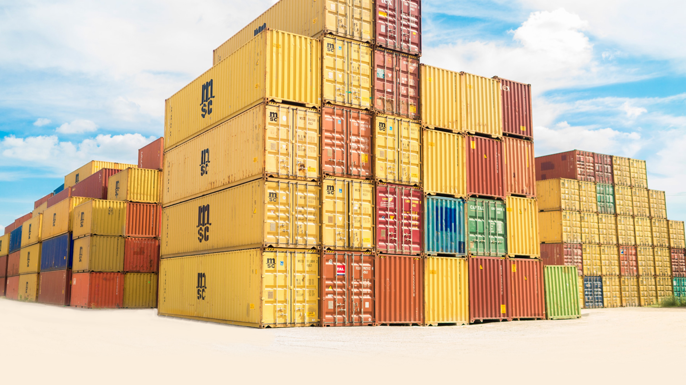
Hopefully your containers would look like

Slide 68

Not like

Slide 69
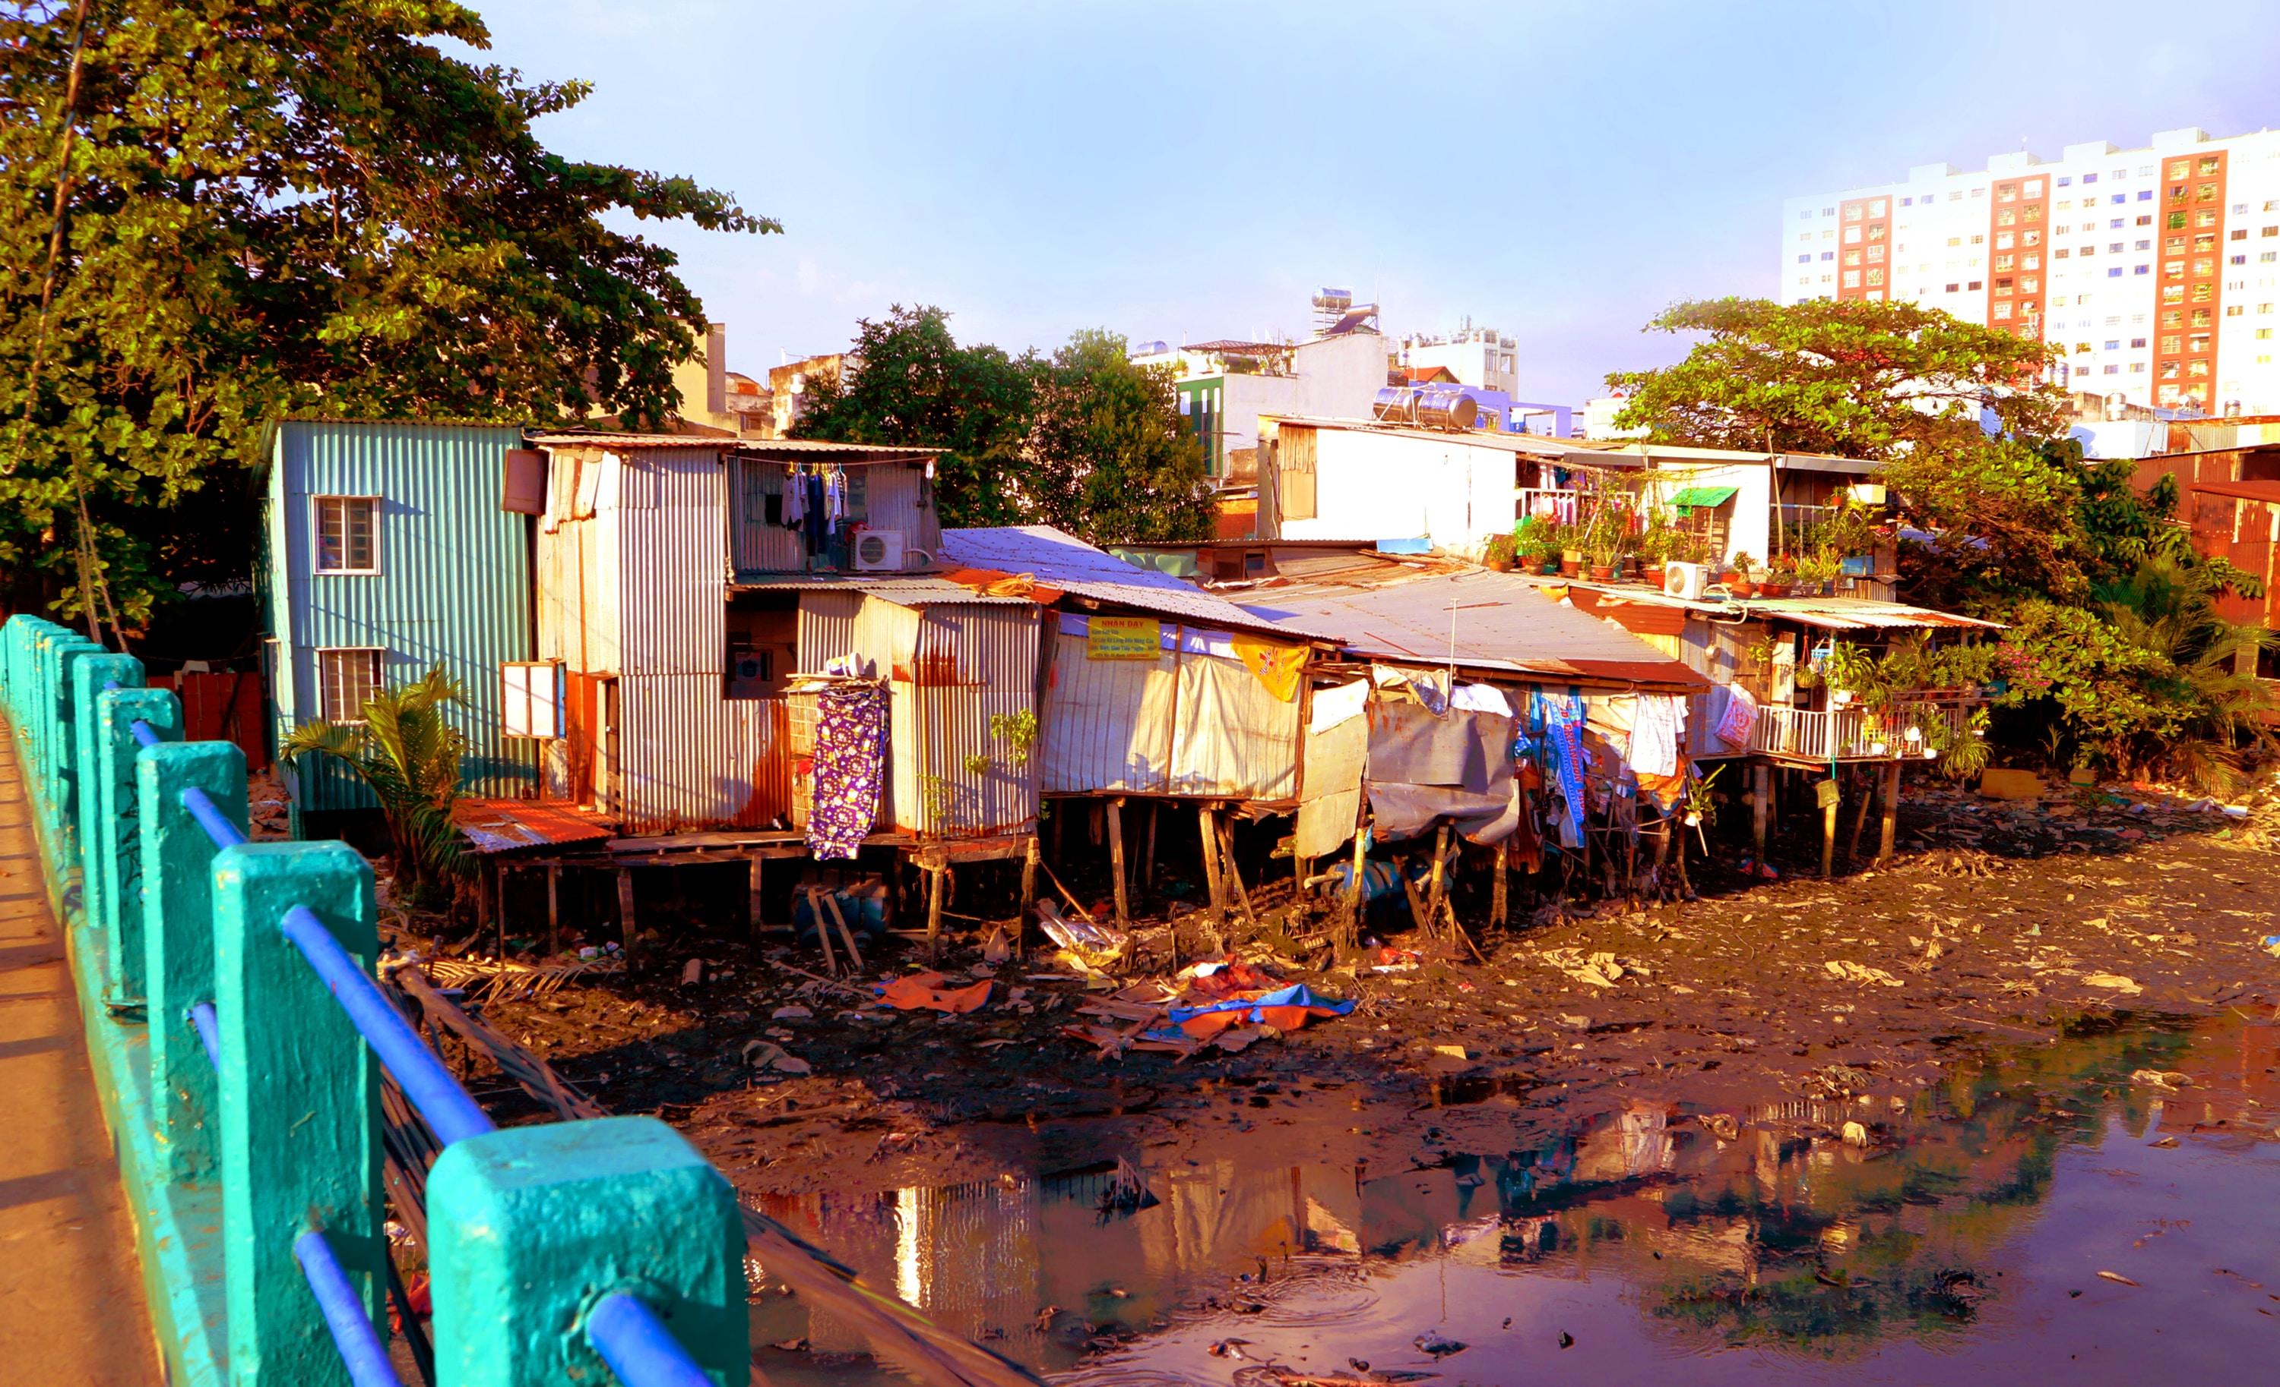
Not like

Slide 70
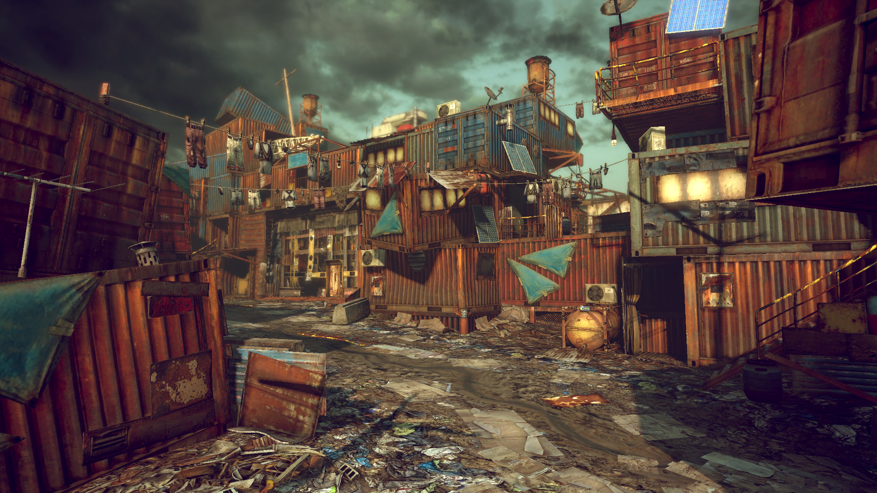
Not like

Slide 71

Q&A

